Slide 1

Math’s 13
Applications of integrals.

Slide 2


Applications of Integrals

Slide 3
Applications of Integrals
So we have seen how integrals can be used to work out the area under the curve of the function.
Another application of the integral is working out the area between two curves.

Slide 4
Applications of Integrals
So we have seen how integrals can be used to work out the area under the curve of the function.
Another application of the integral is working out the area between two curves.

Slide 5
Applications of Integrals
To find the area between two curves we must find where the two curves cross or where f(x) = g(x).
Lets try it for the functions f(x) = x² and g(x) = 2x - x²
x² = 2x + x²

Slide 6
Applications of Integrals
To find the area between two curves we must find where the two curves cross or where f(x) = g(x).
Lets try it for the functions f(x) = x² and g(x) = 2x - x²
x² = 2x - x²
2x² - 2x = 0
2x(x-1) = 0

Slide 7
Applications of Integrals
To find the area between two curves we must find where the two curves cross or where f(x) = g(x).
Lets try it for the functions f(x) = x² and g(x) = 2x - x²
2x(x-1) = 0
Our limits are x = 0 and x = 1

Slide 8
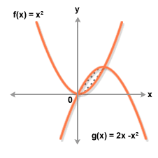
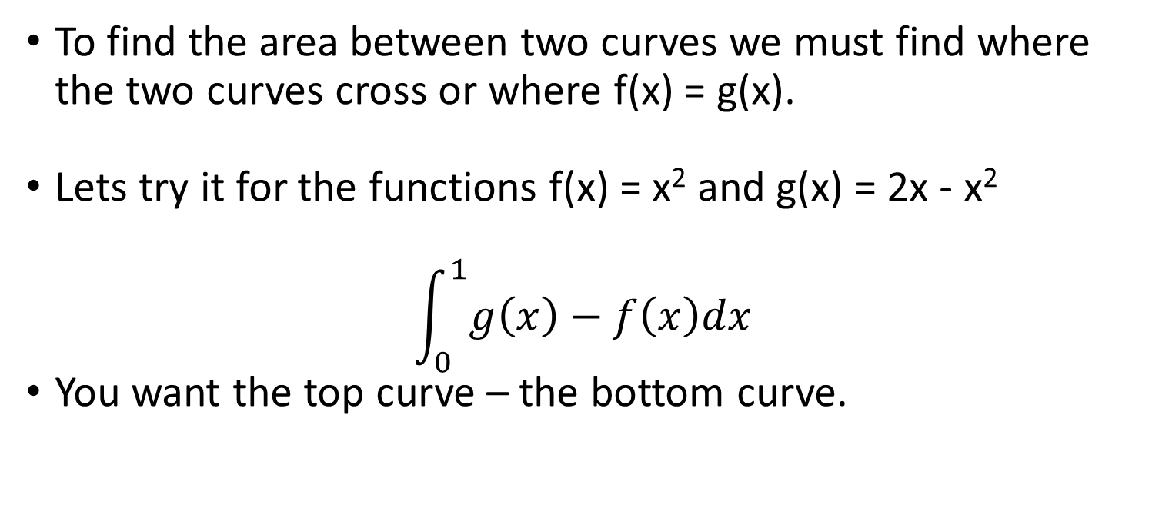
Applications of Integrals
To find the area between two curves we must find where the two curves cross or where f(x) = g(x).
Lets try it for the functions f(x) = x² and g(x) = 2x - x²
$$\int_{0}^{1}{g\left(x\right)−f\left(x\right)dx}$$
You want the top curve – the bottom curve.

Slide 9
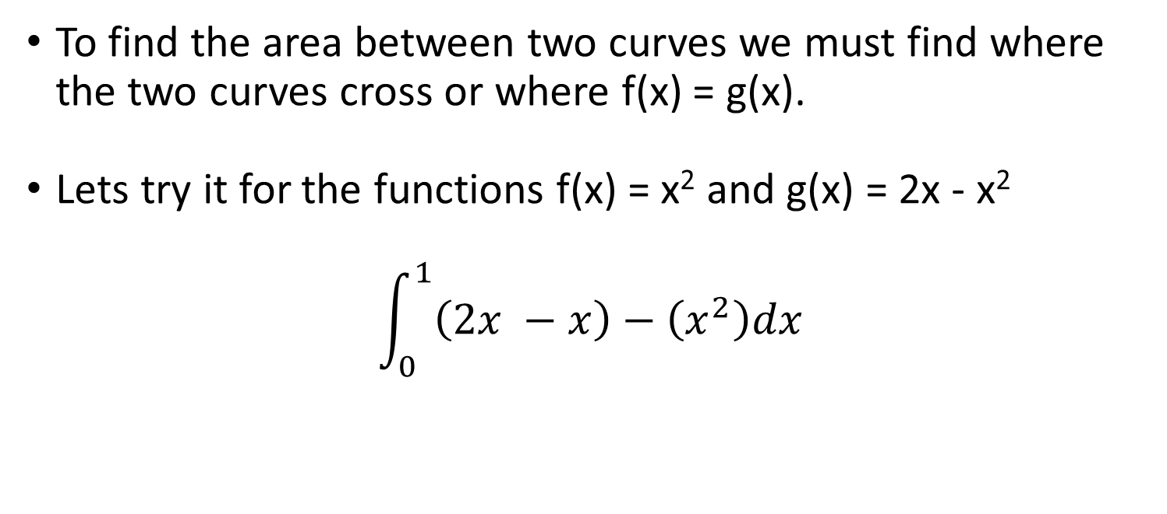
Applications of Integrals
To find the area between two curves we must find where the two curves cross or where f(x) = g(x).
Lets try it for the functions f(x) = x² and g(x) = 2x - x²
$$\int_{0}^{1}{\left(2x −x\right)−\left(x^{2}\right)dx}$$

Slide 10
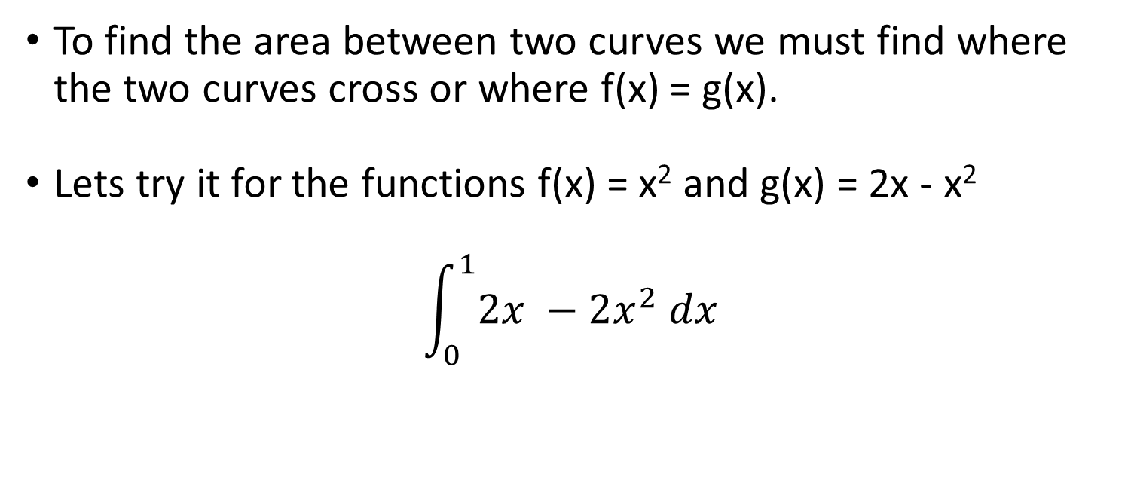
Applications of Integrals
To find the area between two curves we must find where the two curves cross or where f(x) = g(x).
Lets try it for the functions f(x) = x² and g(x) = 2x - x²
$$\int_{0}^{1}{2x −2x^{2} dx}$$

Slide 11
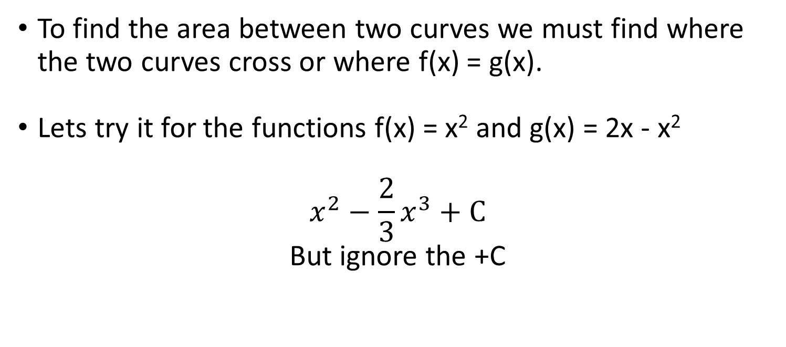
Applications of Integrals
To find the area between two curves we must find where the two curves cross or where f(x) = g(x).
Lets try it for the functions f(x) = x² and g(x) = 2x - x²
$$x^{2}−\frac{2}{3}x^{3}+C$$
But ignore the +C

Slide 12
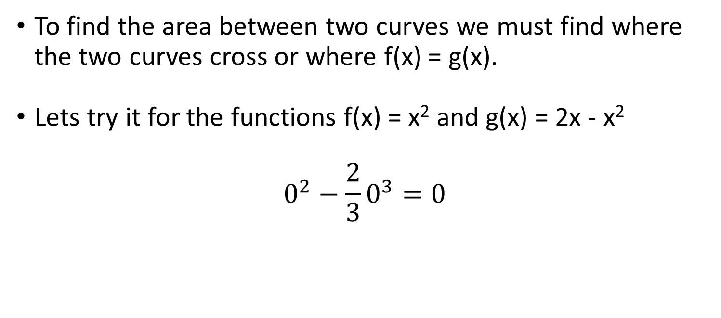
Applications of Integrals
To find the area between two curves we must find where the two curves cross or where f(x) = g(x).
Lets try it for the functions f(x) = x² and g(x) = 2x - x²
$$0^{2}−\frac{2}{3}0^{3}=0$$

Slide 13
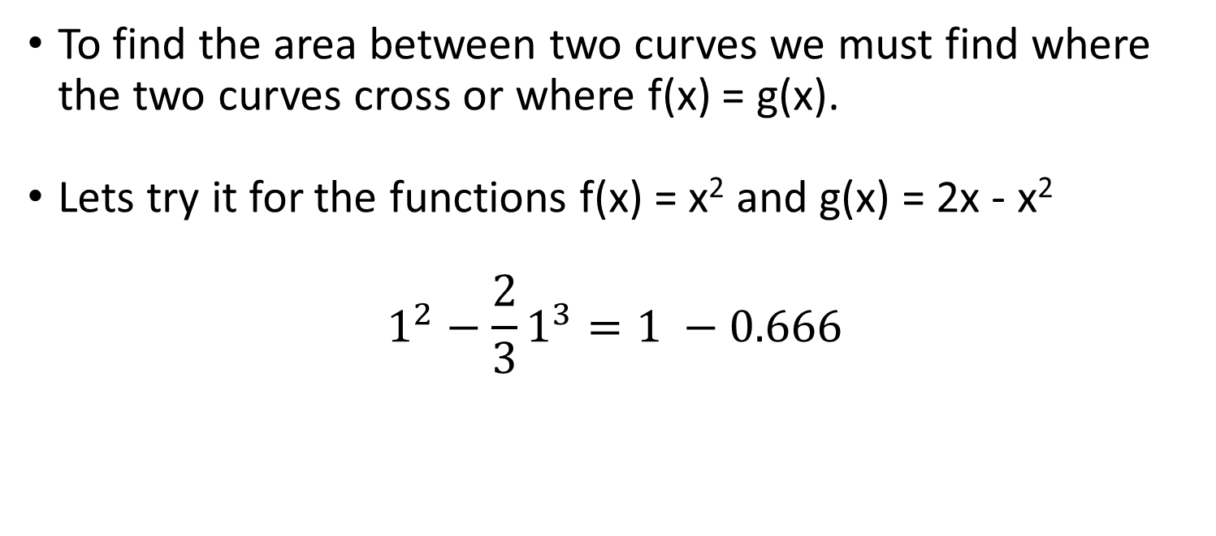
Applications of Integrals
To find the area between two curves we must find where the two curves cross or where f(x) = g(x).
Lets try it for the functions f(x) = x² and g(x) = 2x - x²
$$1^{2}−\frac{2}{3}1^{3}=1 −0.666$$

Slide 14
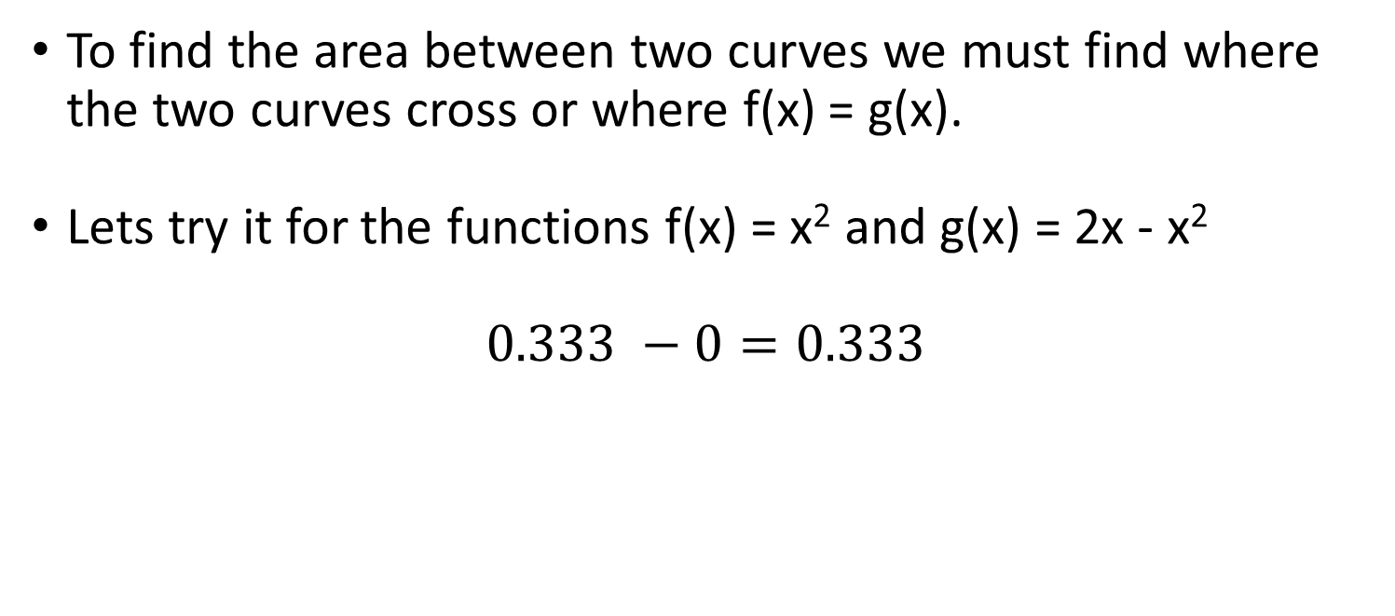
Applications of Integrals
To find the area between two curves we must find where the two curves cross or where f(x) = g(x).
Lets try it for the functions f(x) = x² and g(x) = 2x - x²
$$0.333 −0=0.333$$

Slide 15
Applications of Integrals
We can find the average value of a function between two points by using integrations.
For a continuous function it would be incredibly time consuming to add up every single point in the function and integrate it.

Slide 16

Applications of Integrals
To find the average of a function we use a fairly simple formula.
$$\frac{\int_{a}^{b}{f\left(x\right)dx}}{b −a}$$

Slide 17

Applications of Integrals
To find the average of a function we use a fairly simple formula.
$$\frac{\int_{a}^{b}{f\left(x\right)dx}}{b −a}$$
Let’s give it a go:

Slide 18

Applications of Integrals
$$\frac{\int_{a}^{b}{f\left(x\right)dx}}{b −a}$$
f(x) = 2x + 3 between 2 and 4

Slide 19

Applications of Integrals
$$\frac{\int_{2}^{4}{2x+3 dx}}{4 −2}$$
f(x) = 2x + 3 between 2 and 4

Slide 20

Applications of Integrals
$$\frac{{[x}^{2}+3x]}{4 −2}$$
f(x) = 2x + 3 between 2 and 4

Slide 21

Applications of Integrals
$$\frac{4^{2}+12 −2^{2}+6}{4 −2}$$
f(x) = 2x + 3 between 2 and 4

Slide 22

Applications of Integrals
$$\frac{16+12 −4+6}{4 −2}$$
f(x) = 2x + 3 between 2 and 4

Slide 23

Applications of Integrals
$$\frac{28 −10}{2}$$
f(x) = 2x + 3 between 2 and 4

Slide 24

Applications of Integrals
$$\frac{18}{2}$$
f(x) = 2x + 3 between 2 and 4

Slide 25

Applications of Integrals
$$19$$
f(x) = 2x + 3 between 2 and 4

Slide 26
Improper integrals
So far we have been doing integration on functions that are continuous.
This is generally a requirement of an integral because you cannot work out the area under a curve at a point which is non existent.
If we have a function that is not continuous we can still use integrals called improper integrals.

Slide 27
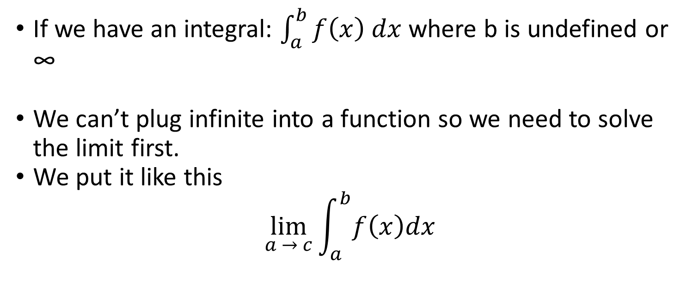
Improper integrals
If we have an integral: $\int_{a}^{b}{f\left(x\right) dx}$ where b is undefined or ∞
We can’t plug infinite into a function so we need to solve the limit first.
We put it like this
$$\lim_{a → c}{\int_{a}^{b}{f\left(x\right)dx}}$$

Slide 28
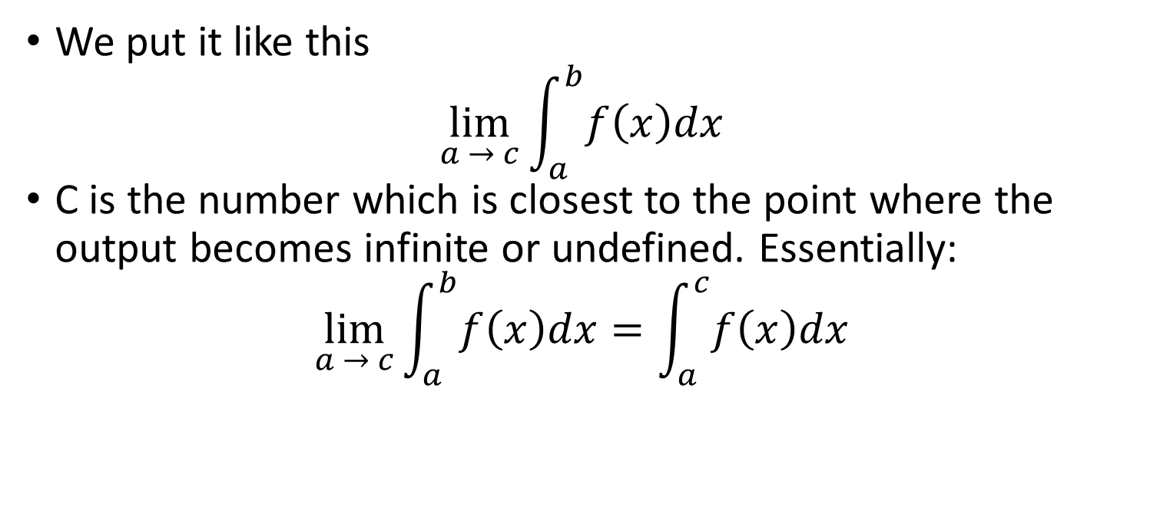
Improper integrals
We put it like this
$$\lim_{a → c}{\int_{a}^{b}{f\left(x\right)dx}}$$
C is the number which is closest to the point where the output becomes infinite or undefined. Essentially:
$$\lim_{a → c}{\int_{a}^{b}{f\left(x\right)dx}}=\int_{a}^{c}{f\left(x\right)dx}$$

Slide 29

Improper integrals
$$\lim_{a → c}{\int_{a}^{b}{f\left(x\right)dx}}=\int_{a}^{c}{f\left(x\right)dx}$$
Lets take a look at how one of these works:

Slide 30

Improper integrals
$$\lim_{a → c}{\int_{a}^{b}{f\left(x\right)dx}}=\int_{a}^{c}{f\left(x\right)dx}$$
Lets take a look at how one of these works:
$$\int_{0}^{1}{\frac{x^{2}−1}{x −1}} dx$$

Slide 31
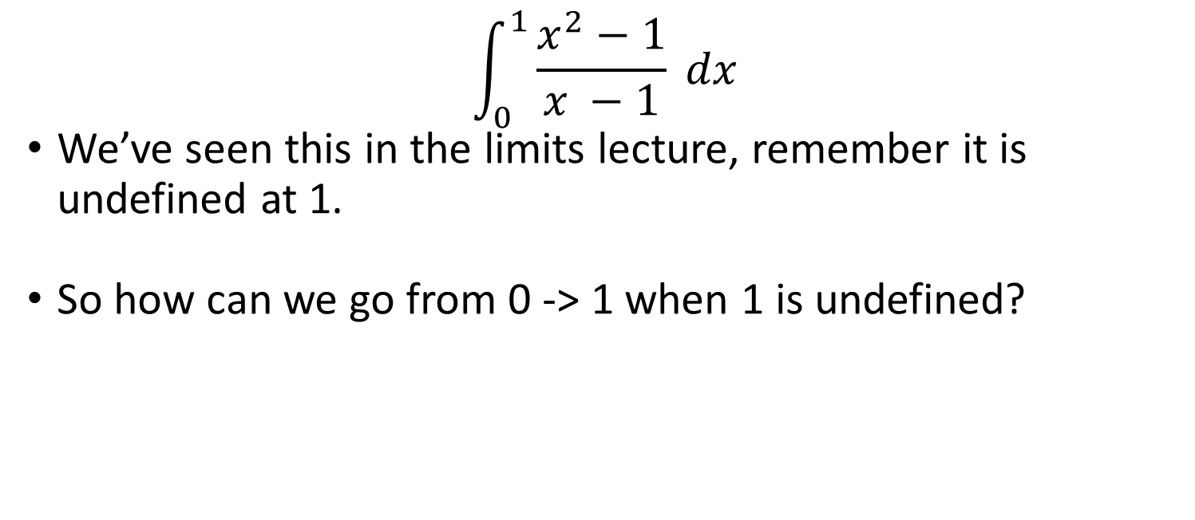
Improper integrals
$$\int_{0}^{1}{\frac{x^{2}−1}{x −1} dx}$$
We’ve seen this in the limits lecture, remember it is undefined at 1.
So how can we go from 0 -> 1 when 1 is undefined?

Slide 32
Improper integrals
$$\int_{0}^{1}{\frac{x^{2}−1}{x −1} dx}$$
We’ve seen this in the limits lecture, remember it is undefined at 1.
So how can we go from 0 -> 1 when 1 is undefined?

Slide 33
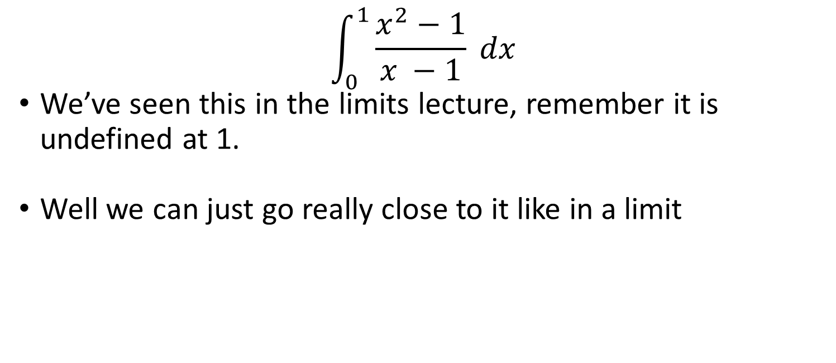
Improper integrals
$$\int_{0}^{1}{\frac{x^{2}−1}{x −1} dx}$$
We’ve seen this in the limits lecture, remember it is undefined at 1.
Well we can just go really close to it like in a limit

Slide 34
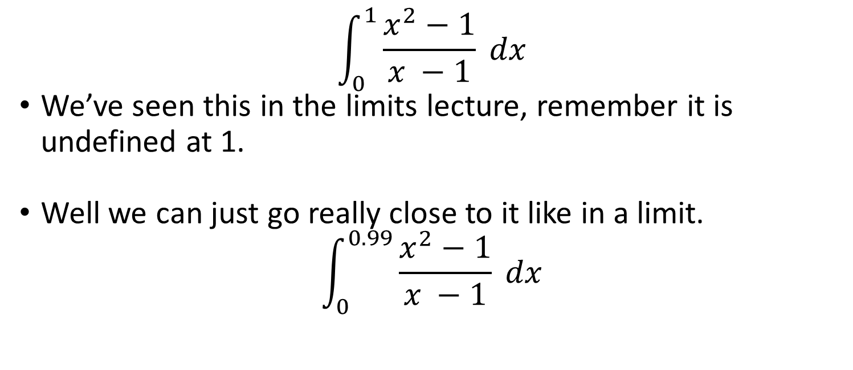
Improper integrals
$$\int_{0}^{1}{\frac{x^{2}−1}{x −1}} dx$$
We’ve seen this in the limits lecture, remember it is undefined at 1.
Well we can just go really close to it like in a limit.
$$\int_{0}^{0.99}{\frac{x^{2}−1}{x −1} dx}$$

Slide 35
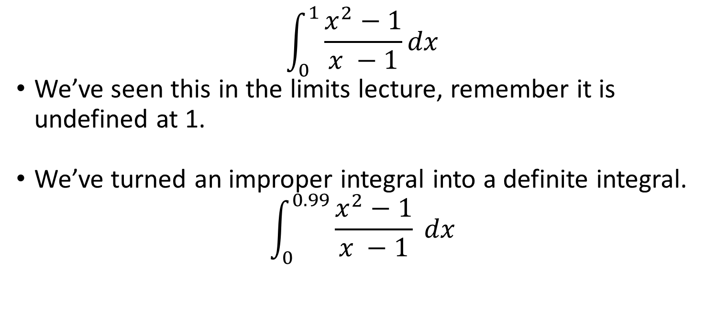
Improper integrals
$$\int_{0}^{1}{\frac{x^{2}−1}{x −1}dx}$$
We’ve seen this in the limits lecture, remember it is undefined at 1.
We’ve turned an improper integral into a definite integral.
$$\int_{0}^{0.99}{\frac{x^{2}−1}{x −1}} dx$$

Slide 36
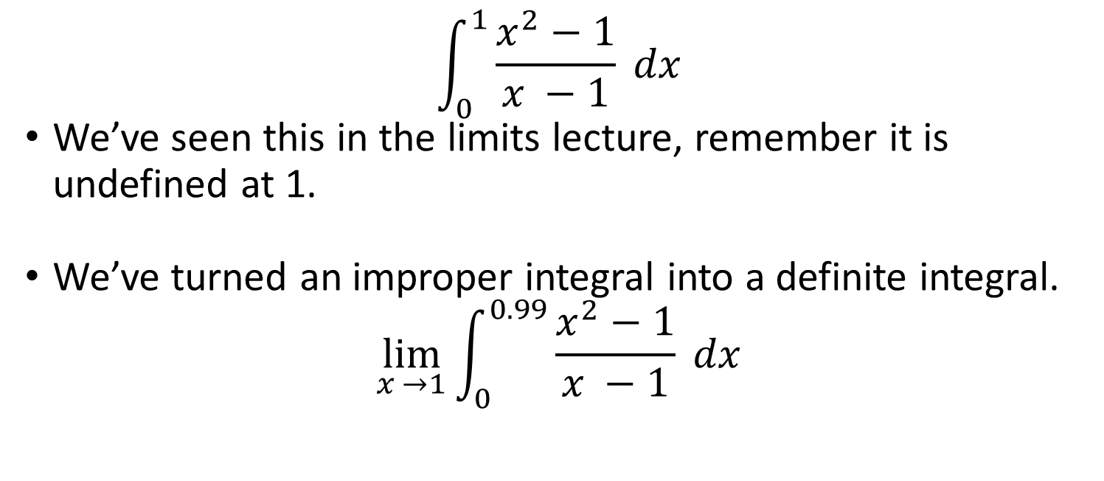
Improper integrals
$$\int_{0}^{1}{\frac{x^{2}−1}{x −1}} dx$$
We’ve seen this in the limits lecture, remember it is undefined at 1.
We’ve turned an improper integral into a definite integral.
$$\lim_{x →1}{\int_{0}^{0.99}{\frac{x^{2}−1}{x −1}}} dx$$

Slide 37
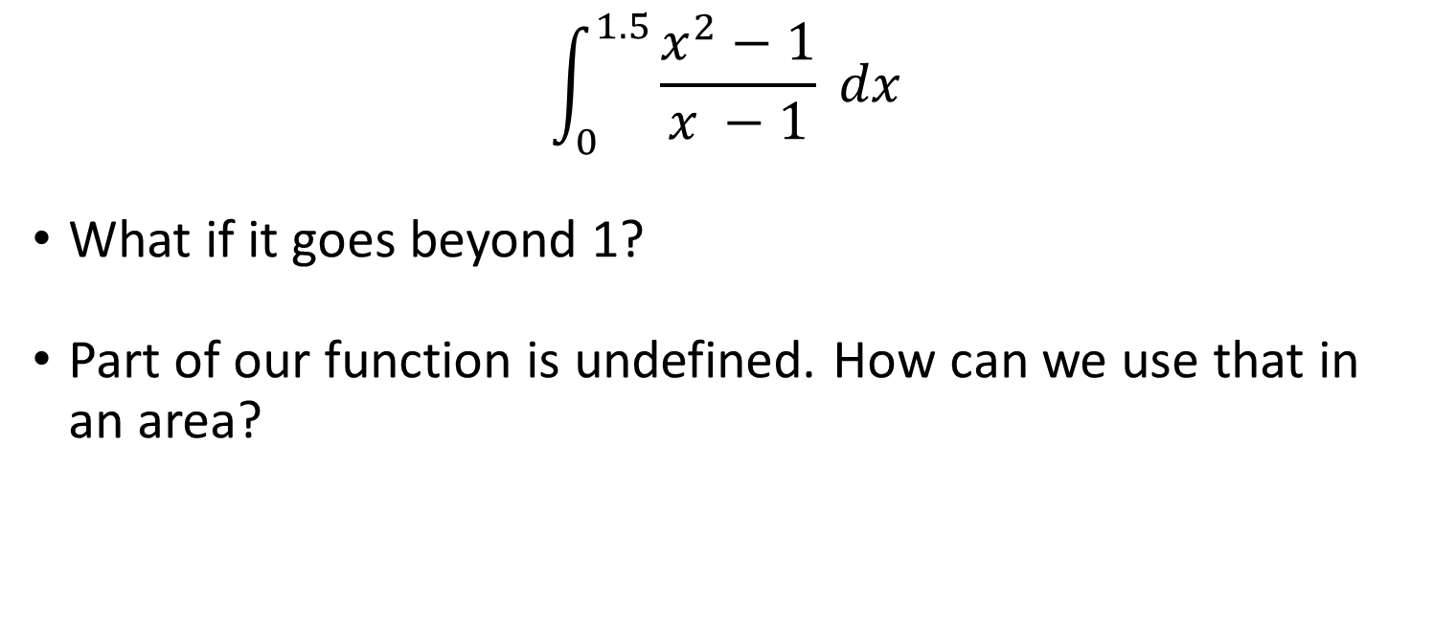
Improper integrals
$$\int_{0}^{1.5}{\frac{x^{2}−1}{x −1}} dx$$
What if it goes beyond 1?
Part of our function is undefined. How can we use that in an area?

Slide 38

Improper integrals
$$\int_{0}^{1.5}{\frac{x^{2}−1}{x −1}} dx$$
Well go either side of it.
$$\int_{0}^{1.5}{\frac{x^{2}−1}{x −1} dx}=\int_{0}^{0.99}{\frac{x^{2}−1}{x −1} dx}+\int_{1.01}^{1.5}{\frac{x^{2}−1}{x −1} dx}$$

Slide 39
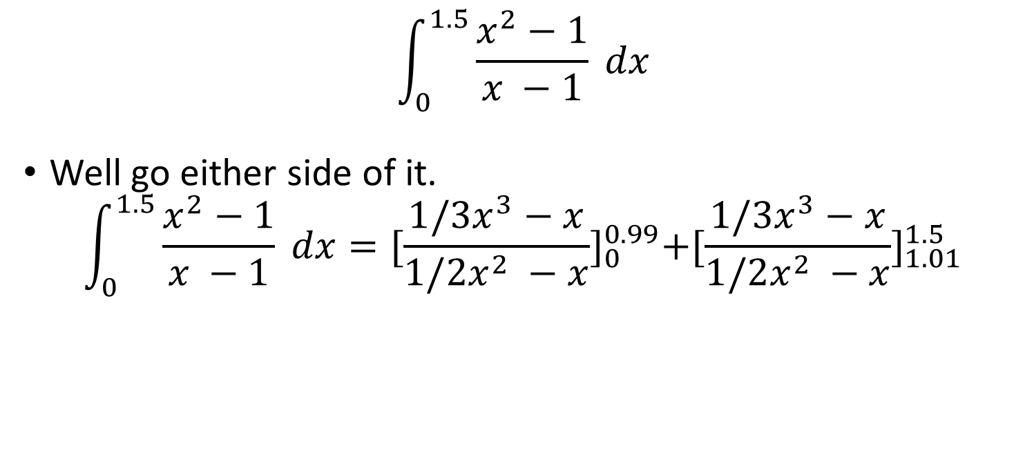
Improper integrals
$$\int_{0}^{1.5}{\frac{x^{2}−1}{x −1}} dx$$
Well go either side of it.
$$\int_{0}^{1.5}{\frac{x^{2}−1}{x −1} dx}={[\frac{{1/3x}^{3}−x}{1/2x^{2} −x}]}_{0}^{0.99}{+[\frac{{1/3x}^{3}−x}{1/2x^{2} −x}]}_{1.01}^{1.5}$$

Slide 40
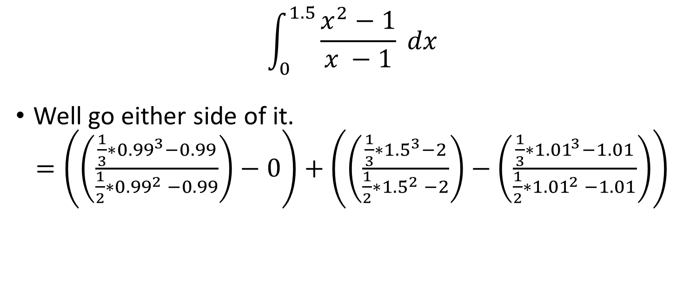
Improper integrals
$$\int_{0}^{1.5}{\frac{x^{2}−1}{x −1}} dx$$
Well go either side of it.
$=\left(\left(\frac{{\frac{1}{3}∗0.99}^{3}−0.99}{\frac{1}{2}∗{0.99}^{2} −0.99}\right)−0\right)+\left(\left(\frac{{\frac{1}{3}∗1.5}^{3}−2}{\frac{1}{2}{∗1.5}^{2} −2}\right)−\left(\frac{{\frac{1}{3}∗1.01}^{3}−1.01}{\frac{1}{2}{∗1.01}^{2} −1.01}\right)\right)$

Slide 41
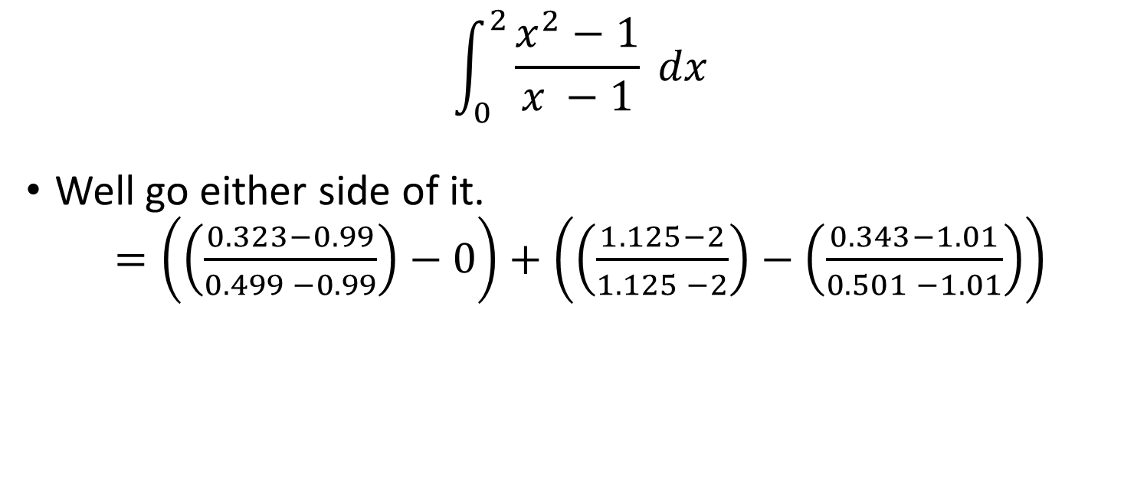
Improper integrals
$$\int_{0}^{2}{\frac{x^{2}−1}{x −1}} dx$$
Well go either side of it.
$=\left(\left(\frac{0.323−0.99}{0.499 −0.99}\right)−0\right)+\left(\left(\frac{1.125−2}{1.125 −2}\right)−\left(\frac{0.343−1.01}{0.501 −1.01}\right)\right)$

Slide 42

Improper integrals
$$\int_{0}^{2}{\frac{x^{2}−1}{x −1}} dx$$
Well go either side of it.
$=\left(\left(\frac{−0.667}{−0.491}\right)−0\right)+\left(1−\left(\frac{−0.667}{−0.509}\right)\right)$

Slide 43

Improper integrals
$$\int_{0}^{2}{\frac{x^{2}−1}{x −1}} dx$$
Well go either side of it.
$=\left(1.358\right)+\left(1−1.310\right)$

Slide 44

Improper integrals
$$\int_{0}^{2}{\frac{x^{2}−1}{x −1}} dx$$
Well go either side of it.
$=\left(1.358\right)+\left(−0.310\right)$

Slide 45
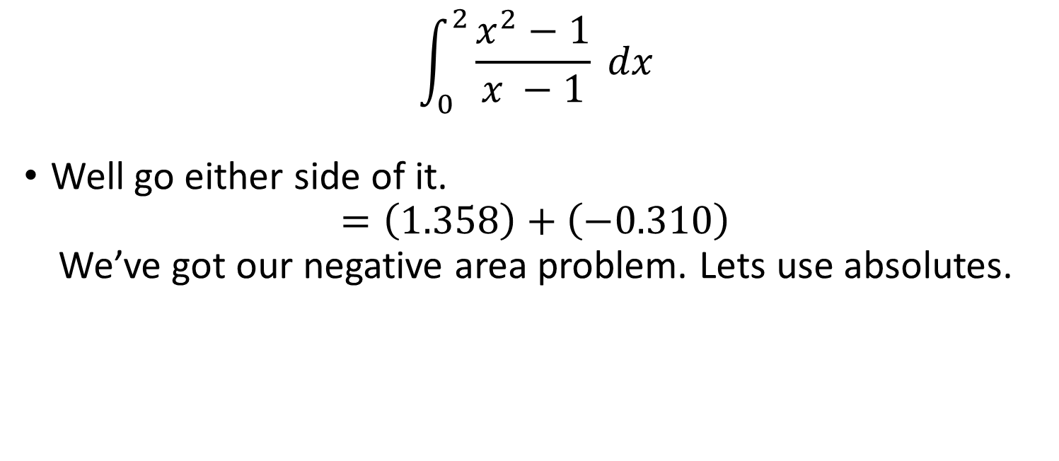
Improper integrals
$$\int_{0}^{2}{\frac{x^{2}−1}{x −1}} dx$$
Well go either side of it.
$$=\left(1.358\right)+\left(−0.310\right)$$
We’ve got our negative area problem. Lets use absolutes.

Slide 46
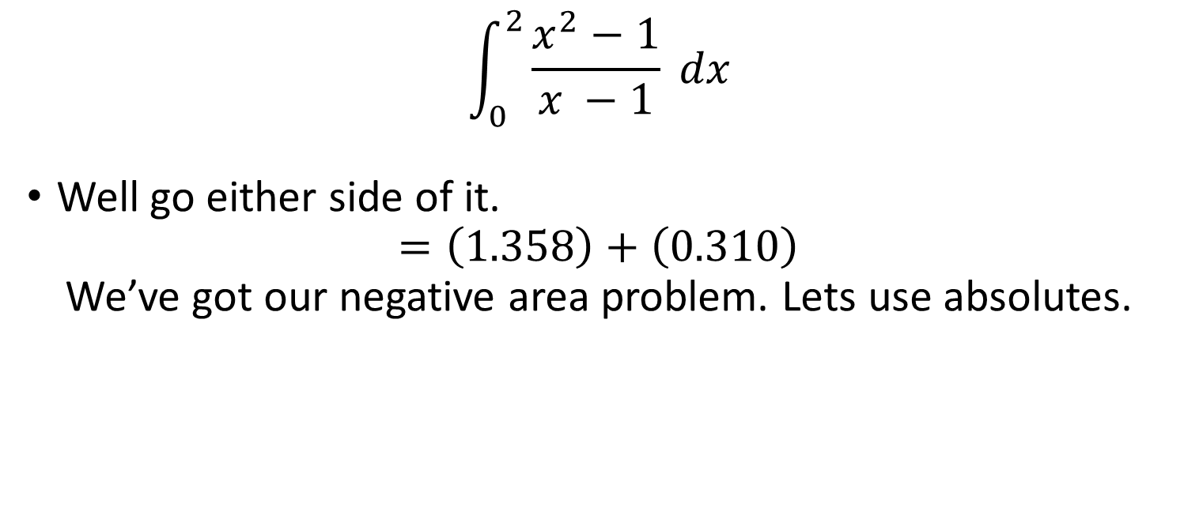
Improper integrals
$$\int_{0}^{2}{\frac{x^{2}−1}{x −1}} dx$$
Well go either side of it.
$$=\left(1.358\right)+\left(0.310\right)$$
We’ve got our negative area problem. Lets use absolutes.

Slide 47

Improper integrals
$$\int_{0}^{2}{\frac{x^{2}−1}{x −1}} dx$$
=
$$1.668$$

Slide 48
L’hopitals rule
If you’re in a coma from too much maths the time to get to the hospital is proportional to the amount of calculus absorbed into the brain…

Slide 49
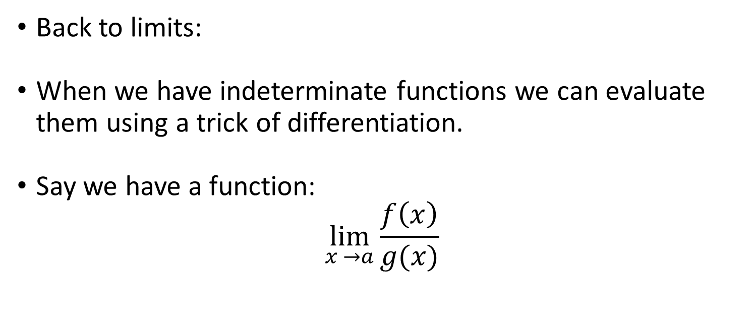
L’hopitals rule
Back to limits:
When we have indeterminate functions we can evaluate them using a trick of differentiation.
Say we have a function:
$$\lim_{x →a}{\frac{f\left(x\right)}{g(x)}}$$

Slide 50
L’hopitals rule
Back to limits:
When we have indeterminate functions we can evaluate them using a trick of differentiation.
Say we have a function:
$$\lim_{x →a}{\frac{f\left(x\right)}{g(x)}}$$

Slide 51
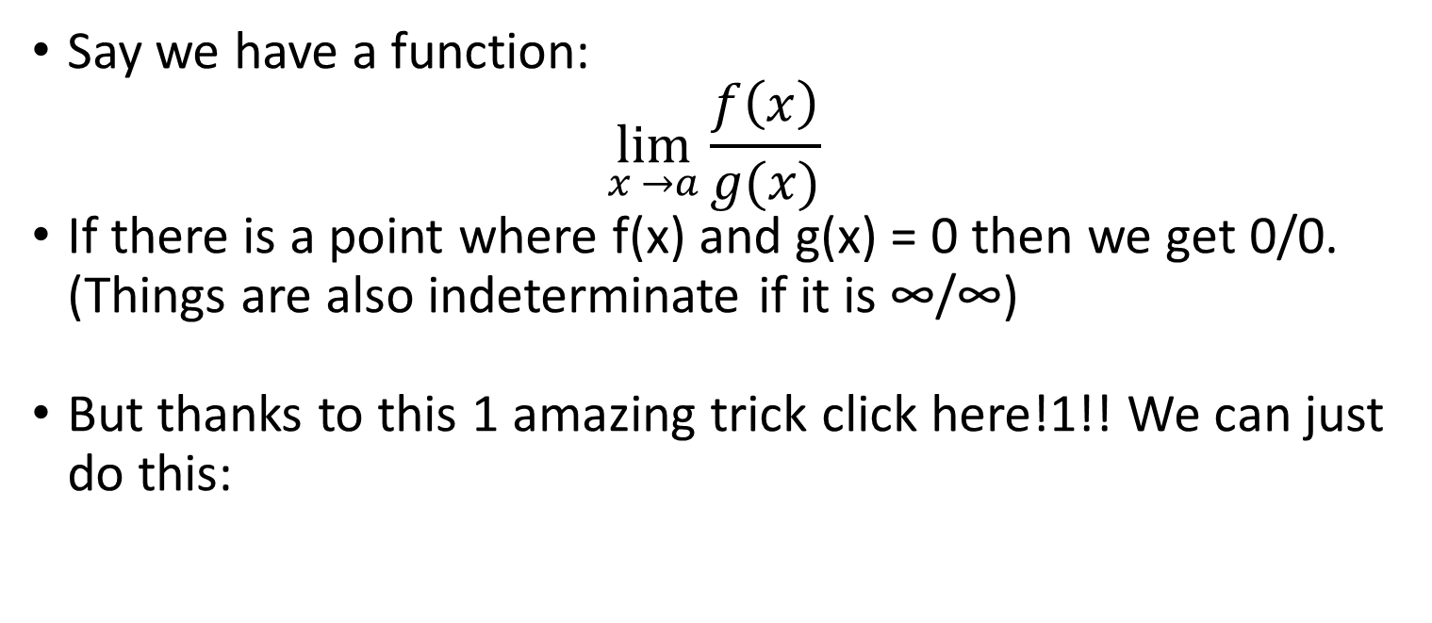
L’hopitals rule
Say we have a function:
$$\lim_{x →a}{\frac{f\left(x\right)}{g(x)}}$$
If there is a point where f(x) and g(x) = 0 then we get 0/0. (Things are also indeterminate if it is ∞/∞)
But thanks to this 1 amazing trick click here!1!! We can just do this:

Slide 52

L’hopitals rule
Say we have a function:
$$\lim_{x →a}{\frac{f\left(x\right)}{g(x)}}$$
=
$$\lim_{x →a}{\frac{f′\left(x\right)}{g′x)}}$$

Slide 53
L’hopitals rule
Say we have a function:
$$\lim_{x →a}{\frac{f\left(x\right)}{g(x)}}$$
=
$$\lim_{x →a}{\frac{f′\left(x\right)}{g′x)}}$$

Slide 54

L’hopitals rule
Lets try the function:
$$\lim_{x →0}{\frac{\sin{x}}{x}}$$

Slide 55

L’hopitals rule
Lets try the function:
$$\lim_{x →0}{\frac{\sin{0}}{0}=\frac{0}{0}}$$

Slide 56

L’hopitals rule
Lets try the function:
$$\underset{x →0}{lim′}{\frac{\cos{x}}{1}}$$

Slide 57

L’hopitals rule
Lets try the function:
$$\underset{x →0}{lim′}{\frac{\cos{0}}{1}}$$

Slide 58

L’hopitals rule
Lets try the function:
$$\underset{x →0}{lim′}{=1}$$

